Slide 1
Building Automated Infrastructures
Adam Jacob
Senior Partner
HJK Solutions
adam@hjksolutions.com
Notes:
13 years as a Systems Administrator
From garages to public companies
How many people are systems administators?
How many people are software developers?
How many people conisder themsleves primarily concerned with business?

Slide 2
Overview
What is an “Automated Infrastructure”?
Why is it so important?
MonkeyNews - A Case Study
Review
Q & A
Notes:
Overview
Why it’s important
Talk about how to do it, and why it’s good, with monkeynews
review
Q & A

Slide 3
Disclaimer
These are the tools we use
They are not the only tools
They may or may not be the right tools for how you work or think
Symbol From IIT Bombay
Notes:
Choosing the components for your infrastructure is like choosing tools for carpentry.
If you don’t have the right tools (hammers, nails, saws, wrenches, clamps, etc) you will suffer for it.
But lots of people make nice hammers
But don’t fool yourself into thinking you can build a nice door without a saw. :)
Cover all the bases in whatever way works best for you

Slide 4
What is an “Automated Infrastructure”?
Notes:
Start by picking apart the two words: Automated and Infrastructure

Slide 5
Automated
”…a process which may once have been performed manually but has been altered in some way which allows a machine or computer to either wholly or partially manipulate the process to save time”
Notes:
Google gives us this definition of the word Automated
So, to Automate sometihing means to take something which you used to do by hand, and let computers do it for you.
A classical example of Automation is the Lighthouse -- you used to have Keepers who monitored the lights 24/7/365. Now they just show up and make sure the maintenance is in order, and that no kids have broken into the lighthouse and had a party.

Slide 6
Infrastructure
“Infrastructure is generally a set of interconnected structural elements that provide the framework supporting an entire structure”
Notes:
Using a City as the metaphor, the Infrastructure are things like roads, power, water, sewer, gas, mass transit, phone service, internet connectivity
Basic services necessary for development to take place
If you don’t have roads, water, and power, it doesn’t make any sense to start building sky scrapers or factories.

Slide 7
Automated Infrastructure
“Having the basic services necessary for your infrastructure to operate largely without the aid of a keeper.”
Notes:
You want all the infrastructure, the “muck” as Jeff Bezos puts it, to be something you don’t have to deal with on a regular basis. Some maintenance here and there, but otherwise, you should be able to focus on building your city, not on how to run a sewer line.

Slide 8
Why is it so important?
Notes:
Any questions about what I mean when I say Automated Infrastructure?
On to why it’s important

Slide 9
To Systems Administrators
Mitigates some failures
You want to be lazy
Repetition leads to burnout
You want to say “Yes”
Notes:
Failure - As a systems administrator, I’ve been on call for more than a decade, and I am tired of being woken up at 3am for a disaster.. So is your staff
Lazy - I was weaned on Perl, and the idea of being as lazy as possible in order to make yourself secretly more efficient might as well be tattoed on my teeth.
Repition - I just got tired of having to re-invent all the parts of the infrastructure every time I did anything, or re-doing a process six months later when I needed to grow it.
Saying Yes - How many people in here have wanted to do something, but had Ops tell them “No” because they didn’t have the bandwidth or time?

Slide 10
For Startups
Time
Efficiency
Scalability
Economics
Flexibility
Notes:
Time - Too many ideas to spend time with Apache, etc. Time is opportunity
Efficiency - Most people could build a working infrastructure, but in a startup do you really want your best developer, systems architect, or CTO to spend time configuring your infrastructure, only to have to repeat it all again when it’s time to grow?
Scalability -
Your application is so good, it’s going to be a Top 10 app on Facebook. (Hi, iLike and Zoosk)
You recognize the power of viral loops and viral networks
If it hits, the curve goes nuts
. (Writing scalable applications is hard enough, and near impossible if you don’t have a scalable infrastructure)
Economics -
You don’t have the money to hire a huge operations staff -- if you can cut out the number of things that must be done on a regular basis, your people can get more done.
You don’t want the what should be trivial details to get in the way of your business. “Don’t sign that huge contract that says we can start tomorrow… we can’t handle the load until a month from now”
Flexibility -
Business is fluid
You need the flexibility to adapt to new circumstances -- business is a series of managed disasters, and adapting your business to the constantly shifting reality of the competitive landscape.

Slide 11
The Jesse Robbins (mis)Quote
“Operations is the act of extracting value from your resources.”
Notes:
Jesse Robbins told me this quote over coffee, and I’ve been repeating it ever since. I think it came form Wikipedia originally, but the gist is:
The point of your Operations is to help you extract value from your resources
You want the path between the resources you have, and the monetization of them, to be as frictionless as possible.

Slide 12
MonkeyNews - A Case Study
All the hottest Monkey news, as selected by your monkey-loving peers!
Courtesy National Geographic
Notes:
We’re going to cover our fictional company, MonkeyNews. We’re going to do that by telling you a bit about the company, then walking you through the various stages of the lifecycle, how you would do it without automation, and how you would do things with automation.
When we talk about doing things Manually, we’re going to keep it as close to apples to apples as we can. If the automated way would have an inventory of servers, we assume there is a manual process that takes it’s place. (To some degree)

Slide 13
What is MonkeyNews
Small Startup
“Like Digg, only about Monkeys”
Notes:
Small Startup - two founders, nobody else, just about to come out of private alpha, being run a laptop attached to one of the founders home DSL line
Planning on monetizing the business by advertising -- so many people love monkeys, they’ll click on monkey ads!

Slide 14
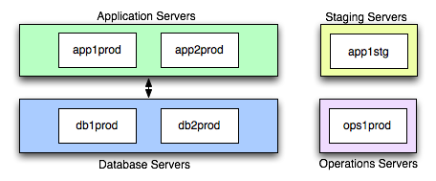
MonkeyNews on Launch Day
Learn More!
John Allspaw - Capacity Management
3:45, right after this
Notes:
So, this is what our two partners drew up on a napkin for launch day.
They understand they need redundancy, and they figure people will go Bananas for monkeynews, so they do pairs.
Application servers are going to be standard Rails servers - Apache, Mongrel, Rails
Database servers are running MySQL, doing drbd failover
Staging servers are running the app + mysql
The ops machine is where they are dumping every other service they need to run.

Slide 15
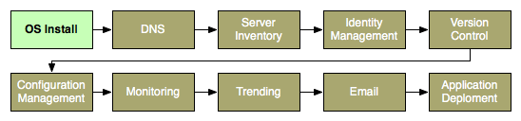
Steps to Launch
Notes:
These are the steps to go from the napkin to actual deployment.
OS Install - Get an operating system up and on a network
DNS - Give your new system a name
Server Inventory - Have a place where you keep track of each system, and what it does
Identity Management - Grant your users access and privileges to your new servers
Version Control - Keep track of the changes to your application code, and ideally, your infrastructure too
Configuration Management - Keep track of how each system is configured, and update it when you make changes
Monitoring - Watch your new systems for signs of trouble
Trending - Make graphs and charts of important metrics, so that you can tell if the infrastructure is behaving well, and predict future capacity
Application Deployment - Actually put your application on the infrastructure, and update it

Slide 16
Steps to Launch - OS Install
Manual
Install each system by hand
1 hour per system
Notes:
We have 6 systems in our initial infrastructure, so the manual mechanism takes about 6 hours.
This is all attended time -- even though you have data transfer happening here, it’s not usually long enough that you can go do something else.
I’ve known people who can do more than one at a time, but most of us mortals just go in a line.

Slide 17
Steps to Launch - OS Install
Automated
Ops1prod built manually
  1 hour
Automated install system (PXE)
EC2, Cloud
Notes:
Build one by hand.
In a traditional infrastructure, you use like Kickstart, Jumpstart, SystemImager and FAI. This means you’re taking bare-metal servers and building the OS on them. In my experience, it takes about 6 hours to get a solid automated build system to the point where it’s reliable enough to build the rest of your infrastructure with. After that, the rest of the servers will take about an hour to build -- but it’s totally unattended time.
With EC2, or another “Cloud” provider, this first server will be the baseline for all your others. Assuming you spend a little time tweaking the image you want to use (a couple of hours should do it), you can fire up all of the nodes you’ll need all at once. (Hence the itty-bitty bit of unattended time, usually around 5 minutes on Ec2)

Slide 18
Steps to Launch - OS Install
Notes:
PXE takes longer, but if you have a traditional infrastructure, every install after that is free beer
The cloud really shines here

Slide 19

Steps to Launch - DNS
Manual
Update each machine in /etc/hosts
Automated
Install a DNS Server
Config Management
Use a service provider
Notes:
Show of hands - how many people in this room can refer to every server in their infrastructure by name? How many people only have to go to one place to update the list of what hosts you have, and their IP addresses?
The graph tells the story, I think. The time it takes to install and configure DNS is negligible, even if you have never touched it before. It’s worth your time, even if you only think about keeping everything in sync.
Lots of good DNS tools, djbdns, bind, maradns. If you hate DNS, that’s fine - you can remove it entirely as long as you have configuraton management in place to update your /etc/hosts files or equivilant. The point is: have one place, centrally managed, that is canonical for the names of your severs.

Slide 20
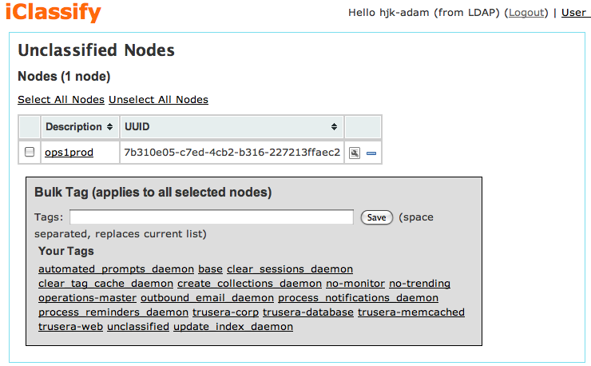


Steps to Launch - Server Inventory
Manual
Use a wiki
Automated
iClassify
LDAP
ControlTier
Roll your own
Notes:
Now that you have servers up, and they have names everyone can see, you need to keep track of the servers you have, and what they do.
This may seem obvious, but I bet 90% of the startups I encounter, and 80% of the large companies, can’t tell you even *how many* servers they have with any degree of reliabaility, much less what each one is doing at any given time. (Even if they have DNS!)
iClassify is a tool we created for doing just this job. It is a small agent that runs on each system, and repors to a centralized web service about the system it’s running on. You can then tag hosts, del.ici.ous style, and search the inventory with a full text search engine (Solr, for the curious.) I’ll talk more about it later. Also, Trusera, a client of ours, graciously let us use their actual infrastructure for these screenshots. Thanks, Trusera. :)
LDAP often already exists for Identity Management in many infrastructures, and as long as you don’t need a lot of complex data, it’s a good place to put your host information.
Lots of people have written databases that do this sort of thing. Use whatever suits you -- but I have to say, making the systems report themselves to the inventory system is a huge, huge win.

Slide 21

Steps to Launch - Identity Management
Manual
Add each user everywhere
Automated
Use LDAP or AD
Configuration Management
Notes:
All that, and we still don’t have users everywhere yet. MonkeyNews is a small company right now, only two people, and six servers. But you still have to figure out who has access to which servers, and what privileges they have.
The manual way to do this is to add each user on every system.
The Automated way is to use a centralized service, such as LDAP or Active Directory.
This graph should look familiar, because it has the exact same automation bonus as DNS does. When you have 5 servers, the 5 minutes it takes seems like no big deal. But that’s 5 minutes for *any user change*.
Password change? 5 minutes.
And the curve is linear.. As you add more servers, you have to add users everywhere, and it takes longer and longer.
Centralize your identity management infrastructure.
Have one user name and password.

Slide 22

Steps to Launch - Version Control
An Easy One
You must use version control
Symbol From IIT Bombay
Notes:
Having a central place to track changes to code and infrastructure, with blame and history
Not really an “automated” vs “manual” thing - you just don’t have a choice :)
Using version control is a requirement of at least two future steps
Subversion, Git, Mercurial, CVS Perforce
Just pick one you like and use it religiously

Slide 23

Steps to Launch - Configuration Management
Manual
Version Control
Wiki
Check in copies of config files
Try and keep a record of what you have done
Notes:
Server Classification says what a thing ought to be, Configuration Management makes it so.
Everything up to deploying your application specific code on all of your servers
This means everything that isn’t done for you at OS installation

Slide 24
Steps to Launch - Configuration Management
Automated
Cfengine
Puppet
Bcfg2
Vertebra?
Infrastructure as Code
Notes:
Automated configuration management is the heart of having an automated infrastructure
Instead of doing things by hand and keeping track of them
You express how the infrastructure should behave as code
Cfengine is the grand old academic dean of Unix/Linux configuration management
Puppet is, in my opinion, the current state of the art
Bcfg2 I have never used, but some folks dig it - XML based config files
Vertebra a new entry here?
Let me show you what I mean with a puppet example that everyone can relate to, managing /etc/sudoers

Slide 25
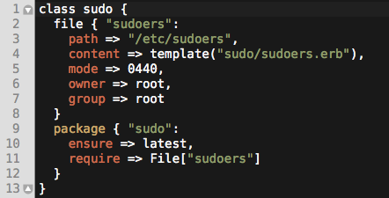
Puppet Example - sudo
Notes:
We build a “sudo” class, to handle all the things we need done on a system to use sudo
Lines 2-8 say, “populate the /etc/sudoers file with the contents of the sudoers.erb template”
Lines 9-12 say, “Make sure the latest sudo package is installed, but only after you drop off the sudoers file”

Slide 26
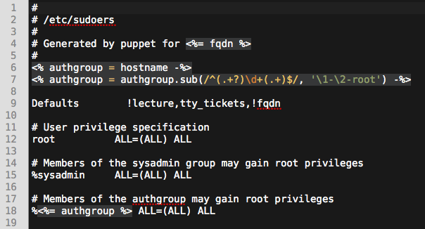
Puppet Example - sudo
Notes:
This is the contents of the sudoers template we talked about before
It sets up root to always be able to sudo, group sysadmin, and an authgroup based on the hostname of the server

Slide 27
Steps to Launch - Configuration Management
Automation is Key
50+ Different Applications
ad, apache2, apt-proxy, beaver, build-essential, capistrano, yum, apt, djbdns, emacs, erubis, rubygems, iclassify, imagemagick, iptables, java, logrotate, man, maradns, memcached, mongrel-runit, munin, mysql, nagios, nscd, ntp, openldap, openssh, perl, perlbal, php, postfix, postgresql, puppet, rails, resolver, rsync, ruby, runit, sqlite, subversion, sudo, trac, zsh
Why repeat yourself?
Notes:
Easy to adapt to wide variation between systems
Incredible time savings
Always current

Slide 28
Puppet - In-depth and Hands-on
Learn more!
Luke Kanies - Puppet Author
4:45 Today

Slide 29

Steps to Launch - Monitoring
Manual
Add each server by hand
Automated
Use your System Inventory and Configuration Management Tools
Notes:
Monitoring, for our purposes, is the act of watching the system for conditions that we want to be notified about. Things like “is this service running”, or “did I make enough money in the last hour”.
In a manual world, you would configure each server (and service) to be monitored by hand
In an automated one, you would configure each class of server one time, and let the automation do the rest
Only edit the config files once for each kind of system
Tools like Nagios can be automated with configruation management, tools like Hyperic and OpenNMS have there own discovery mechanisms

Slide 30

Steps to Launch - Trending
Manual
Add each server and graph by hand
Automated
Use your System Inventory and Configuration Management Tools
Notes:
“The process of extrapolating metrics to make future capacity forecasts.”
Charts and Graphs
Has a similar configuration burden as Monitoring, and an identical solution

Slide 31
Steps to Launch - Email
Another Easy One
Every server must be able to send email locally.
Symbol From IIT Bombay
Notes:
Modern web applications send a ton of email, so make it easy to do
Most linux distributions will send lots of email, so make it easy on them too
Monitoring will want to send email
Use your configuration management system and system inventory to automate the configuration on a per-server basis
Or do it by hand

Slide 32

Steps to Launch - Application Deployment
Manual
Update the application by hand
Automated
Use Capistrano
Use ControlTier
Integrated with System Inventory
Notes:
Application Deployment can be easy, or it can be hard
It can be time consuming, or it can be very quick
The key predictor of either is the number of steps you have to take to deploy
If the number is 0%, and a deploy either succeeds or fails, you have a 0% chance of a deploy related production impacting outage
As the number of steps increases, so does your odds of screwing it up
Someday, Vertebra!

Slide 33
Launch Day

Slide 34
Tech Crunched!
Symptoms
Monitors alert
Trending shows the traffic spike
Your RSS reader has the culprit
Notes:
Lets assume it’s launch day, and we used EC2 for our platform
Our PR guy rocks, our blog offensive was a success, and we’re on the front page of Tech Crunch
The monitors alert because the site is running too slow
The graphs show the traffic spike and resource utilization on the servers in concert

Slide 35

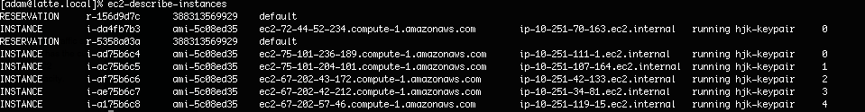
Tech Crunched! - EC2
Launch more capacity.
Two minutes later, they are up

Slide 36
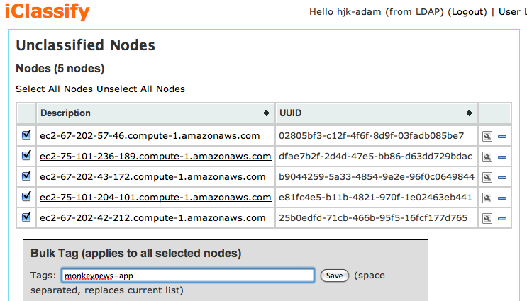
Tech Crunched! - iClassify
Classify the Servers

Slide 37
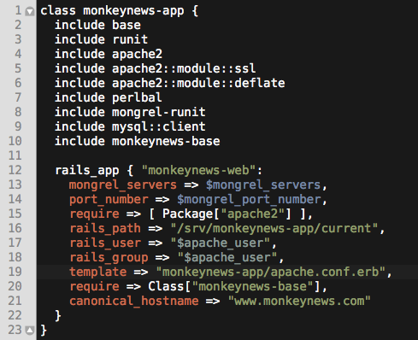
Tech Crunched! - Puppet
Puppet applies the class that matches the tag:

Slide 38
Tech Crunched! - Deploy
Deploy your application!
“cap -S env=prod deploy”
One command.
Notes:
Integrates with iClassify
Finds our new servers
Deploys the code

Slide 39
Tech Crunched! - Post Mortem
Total Time: ~5 - 10 minutes
4 steps total!
We doubled capacity
No configuration during the issue at all
Notes:
This whole process took between 5-10 minutes, most of which is data transfer.
Only took 4 steps to double capacity
No need to re-configure any software at all at the moment of crises
Would have worked just as well with physical hardware, if you had it on hand
Just changes the time to 30-40 minutes, most of which is data transfer

Slide 40
New Hire
Issue
MonkeyNews hires a new engineer
Resolution
Add the user to LDAP
Add the right group privileges

Slide 41
Add SSL Support
Issue
MonkeyNews has started taking micro-payments (for bananas)
Resolution
Update Apache Virtual Host in your Configuration Management
Add the SSL Certificates to Configuration Management
< 10 minutes from start to finish
Notes:
Total time, regardless of infrastructure size

Slide 42
Migrate to the Clouds
Issue
MonkeyNews has started doing photo-sharing of monkeys!
Need to do big image uploading and serving
Too expensive and spikey for our tiny infrastructure
Resolution
Use EC2
Instances talk to iClassify
Puppet builds them like any other host
Monitoring, Trending, Identity, all done
Just Deploy.

Slide 43
Review

Slide 44
Review
Automated Infrastructure means:
  “Having the basic services necessary for your business to operate largely without the aid of a keeper.”
Automated Infrastructure
  Saves time
  Increases efficiency
  Allows for scalability
  Reduces economic impact
  Improves flexibility

Slide 45
HJK does this for a living.
But you can ask me how to do it for free. :)
Adam Jacob
+1 (206) 508-4759
adam@hjksolutions.com
http://is.gd/EML - List of Tools Mentioned

